Slide 1
Generate Gaussian samples
Khanh Nguyen

Slide 2
Thank you
Prof Merialdo
Buu
Giau
Bao

Slide 3
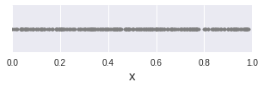
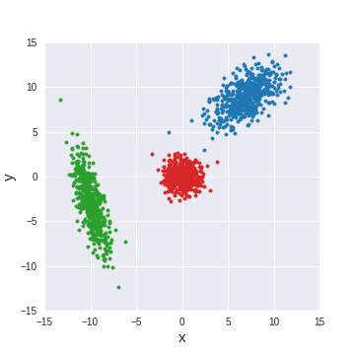
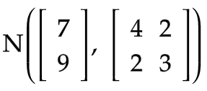
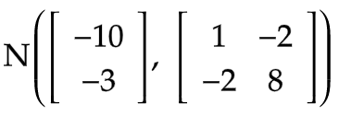
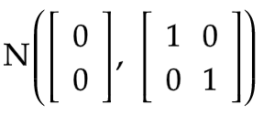

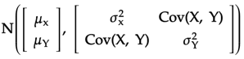
Outline
Given: Uniform random generator (numpy.random.uniform, runif)
Goal: "Generate artificial data for 2 classes, where each class is a Gaussian in the plane, N data points for each class"
For each class, generate iid (indpendent & identically distributed) points in which X and Y are independent N(0, 1)
Modify mean, variance, and covariance for the samples in each class
Repeat step 1 & 2 for the other class
②
③
①
N(0, 1)
N(0, 1)
mean vector
covariance matrix

Slide 4
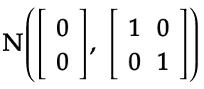
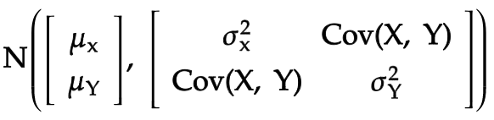
Outline
How to generate N(0, 1) from Unif(0, 1)
Inversion sampling
Box-Muller transform
"Mystery method"
How the N(0, 1) generators are implemented in R and Python
How to transform into
Applications of Gaussian sampling

Slide 5
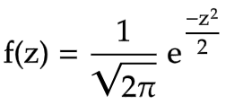
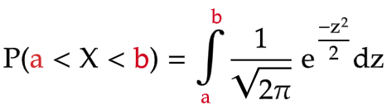
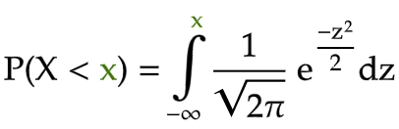
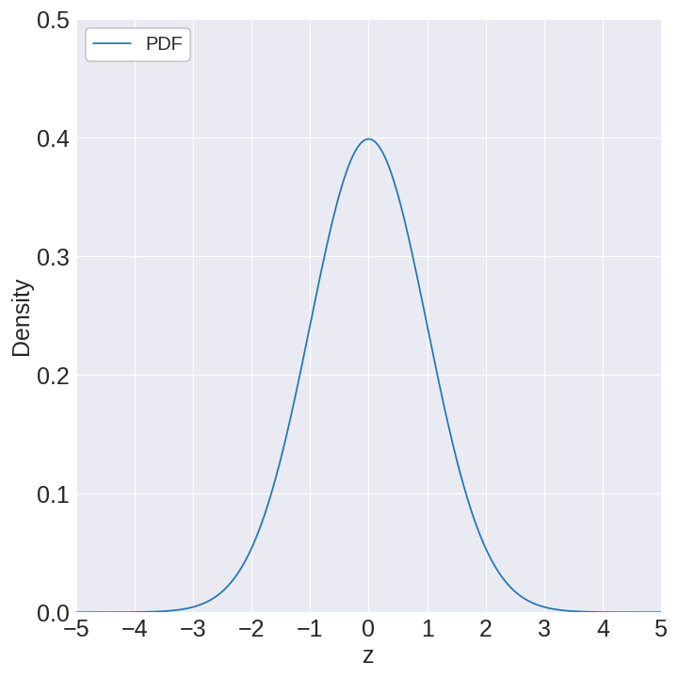
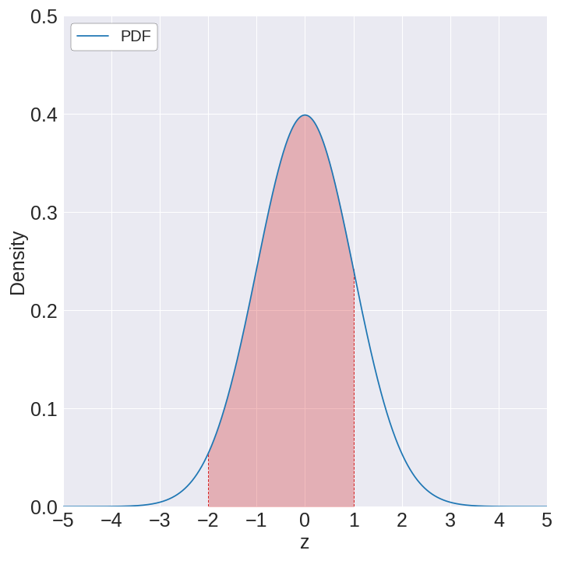
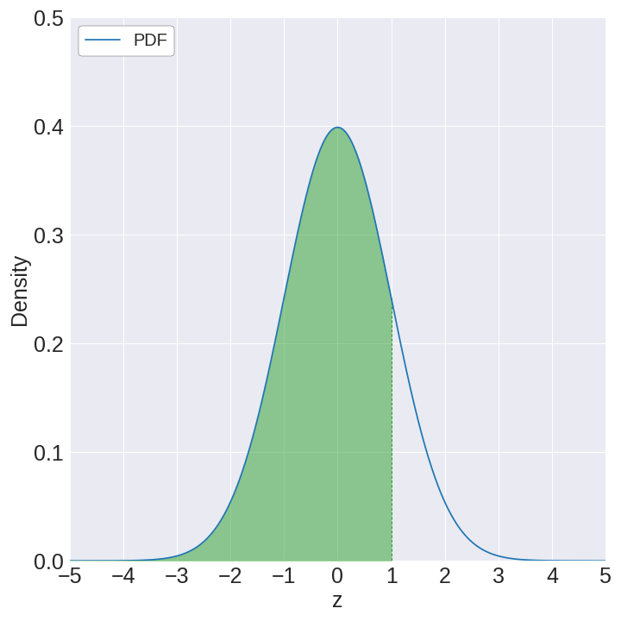
Inversion sampling
Probability density function of X ~ N(0, 1)
Cumulative probability = Area to left of x
Function that maps
Position (x) ⇨ Area
a
b
x

Slide 6
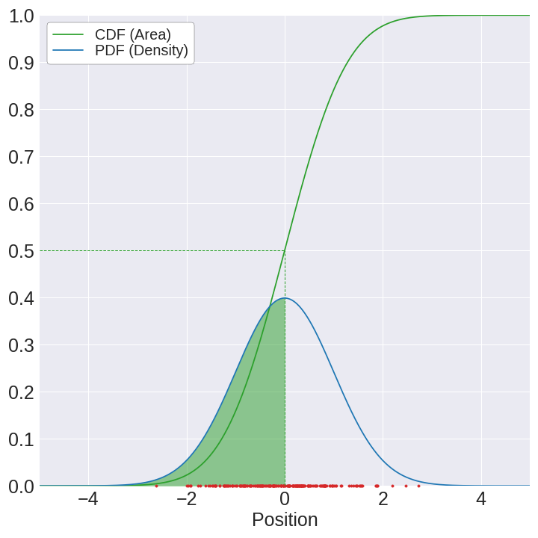
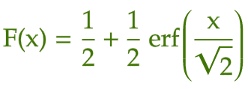
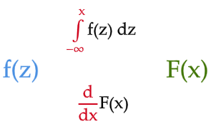
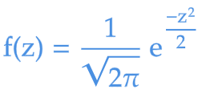
Cumulative distribution function
Converts position at a point into cumulative probability (area to the left of that point)
… the steeper the CDF is at that point
The higher the PDF is at some position ...
… the denser the samples are around it

Slide 7
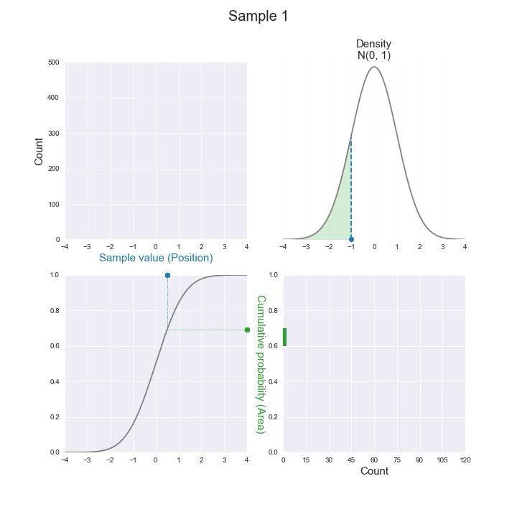
For any distribution, the cumulative probability (left-side area) is always uniformly-distributed!

Slide 8
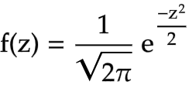
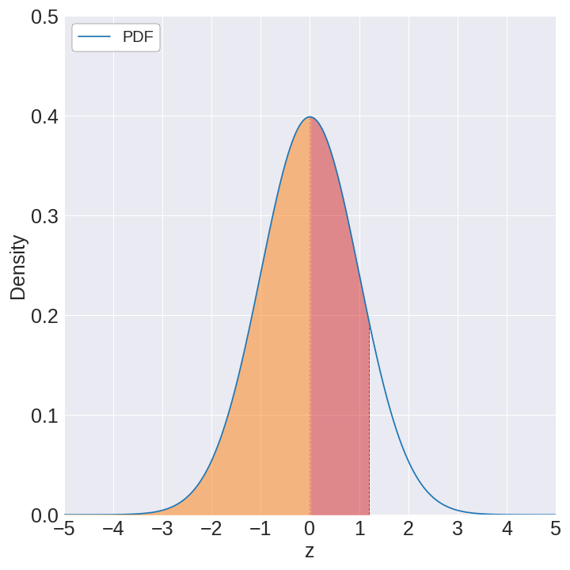
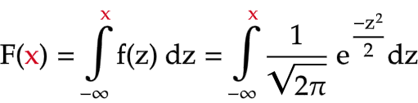
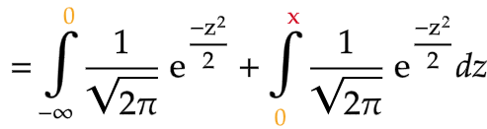
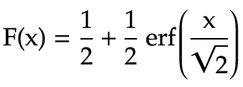

PDF of N(0, 1)
CDF of N(0, 1)
x
1/2
Common formula for CDF of N(0, 1)

Slide 9
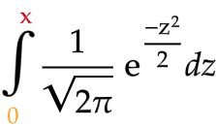
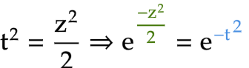
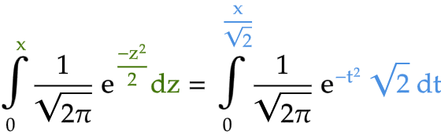
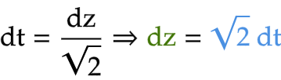
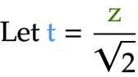
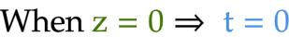
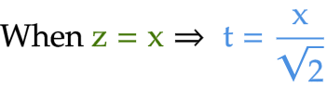
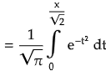
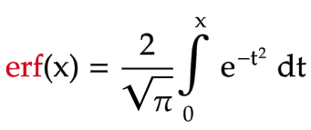
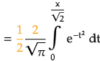
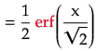
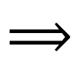
Start:
$$⟹$$

Slide 10
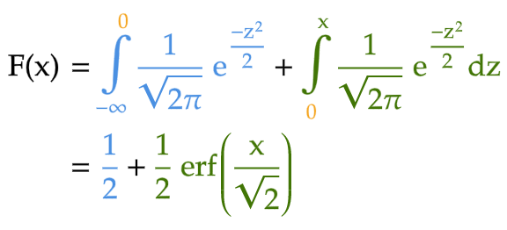
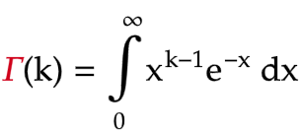
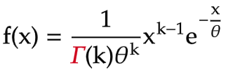
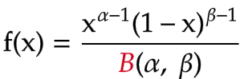
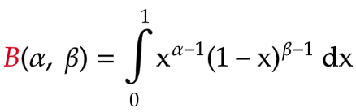
CDF of N(0, 1)
Don't be scared of strange notations in math!
Gamma distribution
Gamma function
Beta distribution
Beta function

Slide 11
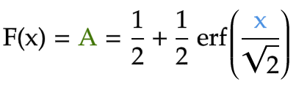
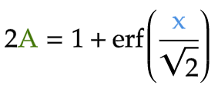
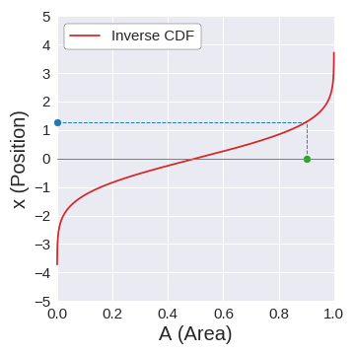
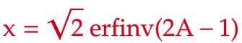
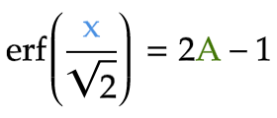
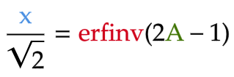
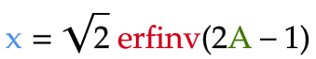




Find inverse CDF of N(0, 1)
$$⟹$$
$$⟹$$
inverse function of erf
$$⟹$$
$$⟹$$

Slide 12
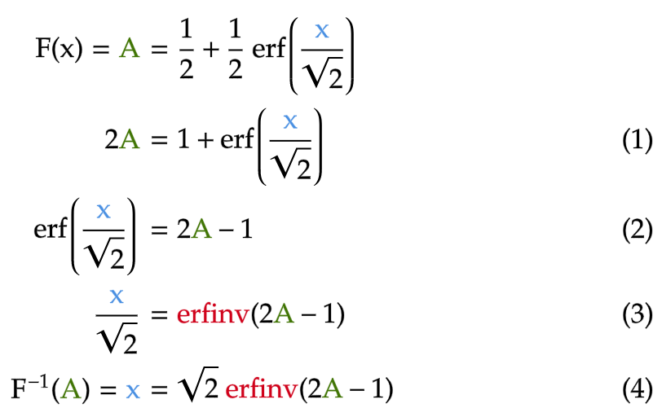
Start:
End:

Slide 13
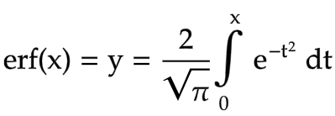

Evaluate erfinv
There's no expression for erfinv!
⇒ The only thing we can write:

Slide 14
no closed-form expression for “y in terms of x”

Slide 15

Start:
End:

Slide 16





Approximate erfinv
Taylor series approximation of f(x) around x=a
Taylor series approximation of f(x) around x=0
⇓
0

Slide 17


Taylor series approximation of f(x)
Taylor series approximation of f(x) near x = 0
Taylor series approximation of erfinv(x) near x = 0
0

Slide 18






Start:
Differentiate:
(chain rule)
First derivative of erf(x)
1st fundamental theorem of calculus
Outer derivative

Slide 19





$$⟹$$
Inner derivative
$$⟹$$
When x = 0

Slide 20














Higher derivatives of erfinv
Pattern:
F'
“updated” P for n+1

Slide 21




First derivative
Third derivative
Second derivative
Derivative of order 3
E’ to power of 3
P: polynomial of E

Slide 22


Given:
Then:
Derivative of order n+1
E’ to power of n+1
Polynomial of E

Slide 23






Update P (polynomial of F)
0 1 2
index = power
p = [2, 0, 8]
value = coefficient
Code
Math
def update_p(p, n):
fp = [0] + p
two_nfp = [2*n*coeff for coeff in fp]
dp = [power * coeff
for power, coeff in enumerate(p)][1:]
updated_p = [two_nfp_coeff + dp_coeff
for two_nfp_coeff, dp_coeff
in zip_longest(two_nfp, dp, fillvalue=0)]
return updated_p
=> [0, 2, 0, 8]​
=> [0, 12, 0, 48]​
X
=> [0, 0, 16]
=> [0, 28, 0, 48]

Slide 24










Start:
P for E’’’
n =3
update_P([2, 0, 8], 3)
def update_P(P, n):
EP = [0] + P
two_nEP = [2 * n * coeff for coeff in EP]
dP = [power * coeff
for power, coeff in enumerate(P)][1:]
updated_P = [two_nEP_coeff + dP_coeff for
two_nEP_coeff, dP_coeff in
zip_longest(two_nEP, dP, fillvalue=0)
return updated_P
Code
Math
=> [0, 2, 0, 8]​
=> [0, 12, 0, 48]​
=> [0, 0, 16]
X
=> [0, 28, 0, 48]
updated P for E⁽⁴⁾
End:

Slide 25

Math
Code
0 1 2
index = power
P = [2, 0, 8]
value = coefficient

Slide 26


Taylor series approximation of erfinv(x)

Slide 27


T₁(2A-1)
T₃(2A-1)
T₅(2A-1)

Slide 28








Evaluate Taylor series approximation of erfinv around 0
https://en.wikipedia.org/wiki/Error_function#Inverse_functions

Slide 29



Taylor series approximation under samples large values

Slide 30

The more power the Taylor series approximation has, the more “blob-like” the samples become

Slide 31
Outline
How to generate N(0, 1) from Unif(0, 1)
Inversion sampling
Box-Muller transform
"Mystery method"
How the N(0, 1) generators are implemented in R and Python
How to transform into
Applications of Gaussian sampling

Slide 32








Comparison to inversion sampling
inverse CDF of N(0, 1)
Inversion sampling
Box-Muller transform

Slide 33












How does it work?
Starting point: X & Y are independent

Slide 34






The key to Box-Muller transform: transforming (X, Y) to (S, θ)
1
Determinant of Jacobian matrix of transformation from (X, Y) to (S, θ)
Instead of sample independent N(0, 1)’s for X and Y,
sample independent S (“half of squared radius”): Expo (1) and angle θ: Unif(0, 2π)

Slide 35




Slide 36
Outline
How to generate N(0, 1) from Unif(0, 1)
Inversion sampling
Box-Muller transform
"Mystery method"
How the N(0, 1) generators are implemented in R and Python
How to transform into
Applications of Gaussian sampling

Slide 37






Inversion sampling
Box-Muller transform
Mystery method
…
…

Slide 38




Central Limit Theorem
Sometimes, thinking outside the box means looking deeply into the box

Slide 39

The more uniforms are added, the more Gaussians the samples become

Slide 40

Rescaling to N(0, 1) after CLT

Slide 41
Outline
How to generate N(0, 1) from Unif(0, 1)
Inversion sampling
Box-Muller transform
"Mystery method"
How the N(0, 1) generators are implemented in R and Python
How to transform into
Applications of Gaussian sampling

Slide 42

R: rnorm (inversion sampling)
minimax = minimize the maximum difference the real and approximate function (within some interval)

Slide 43


R: rnorm (inversion sampling)
r-source/blob/trunk/src/nmath/qnorm.c
different approximation technique for different regions
minimax
rational
Horner’s method (reduce number of operations to calculate polynomial)

Slide 44


Python (Box-Muller)
numpy/numpy/random/mtrand/randomkit.c
https://stackoverflow.com/questions/51228069/how-to-find-method-implementation-in-numpy-repo
Polar form of Box-Muller transform

Slide 45
Outline
How to generate N(0, 1) from Unif(0, 1)
Inversion sampling
Box-Muller transform
"Mystery method"
How the N(0, 1) generators are implemented in R and Python
How to transform into
Applications of Gaussian sampling

Slide 46







Introduce mean, variance and covariance to generated Gaussian samples
Linear transformation of a Gaussian vector is also a Gaussian vector

Slide 47






How to find A?
numpy/numpy/random/mtrand.pyx
Cholesky decomposition
SVD

Slide 48









Generate new data points
80%
0%
Query synthesis approach
(much less used than more popular pool-based sampling)
50%
20%
100%
Lang & Baum 1992 “Query Learning Can Work Poorly when a Human Oracle is Used”
40%
60%
Zhu & Bento 2017“Generative Adversarial Active Learning”

